Slide 1


K.L.E. Dr. M.S. SHESHGIRI COLLEGE OF ENGINEERING AND TECHNOLOGY DEPARTMENT OF ELECTRONICS AND COMMUNICATION ENGINEERING BELAGAVI-590008
WATER MONITORING SYSTEM USING HYDROPONICS AGRICULTURE
Under the guidance of
Prof.Sushant Jadhav
Team members
Prajwal Sampgaon - 2KL16EC050
PavanKumar Budihal- 2KL16EC048
Meghana P R- 2KL16EC035
Apoorva Sangam - 2KL16EC012

Slide 2
INTRODUCTION
WHAT IS HYDROPONICS
“Growing plants in water without using soil
Hydroponics is a technique in which plant grow without using the soil. This technique take cares that the plant gets all nutrients which are required from the water solution. There so many types of hydroponic techniques. One of the techniques is water culture(WC).
Water culture is a technique that supplies the nutrient directly to the roots of the plant until the plant can be harvested. In this technique the plant root will be always submerged into the water containing nutrient and oxygen.

Slide 3
LITERATURE SURVEY
Hydroponics is one of the best alternatives for plants on narrow land. There have been several papers published in several journals in hydroponics system in recent years; they suggest how hydroponics plant systems work.
According to P Sihombing, N A Karina, J T Tarigan and M I Syarif that the waste nutrients from hydroponics plants can be reused.
Another paper is the role of hydroponics technique as a standard methodology in various aspects of land biology researches, this paper provides a basic idea of hydroponic water culture. This paper also discuss the methodology used to measure pH values of the sensors and also maintains water levels in hydroponic reserviors. This paper also address the difficulties of control that occurred during automation.

Slide 4
COMPONENTS USED
RASPBERRY PI3
DS18B20 TEMPERATURE SENSOR
SOIL MOISTURE SENSOR
WATER INDICATOR
AIRPUMP
NUTRIENTS
NET POTS
PVC PIPES
LCD DISPLAY

Slide 5
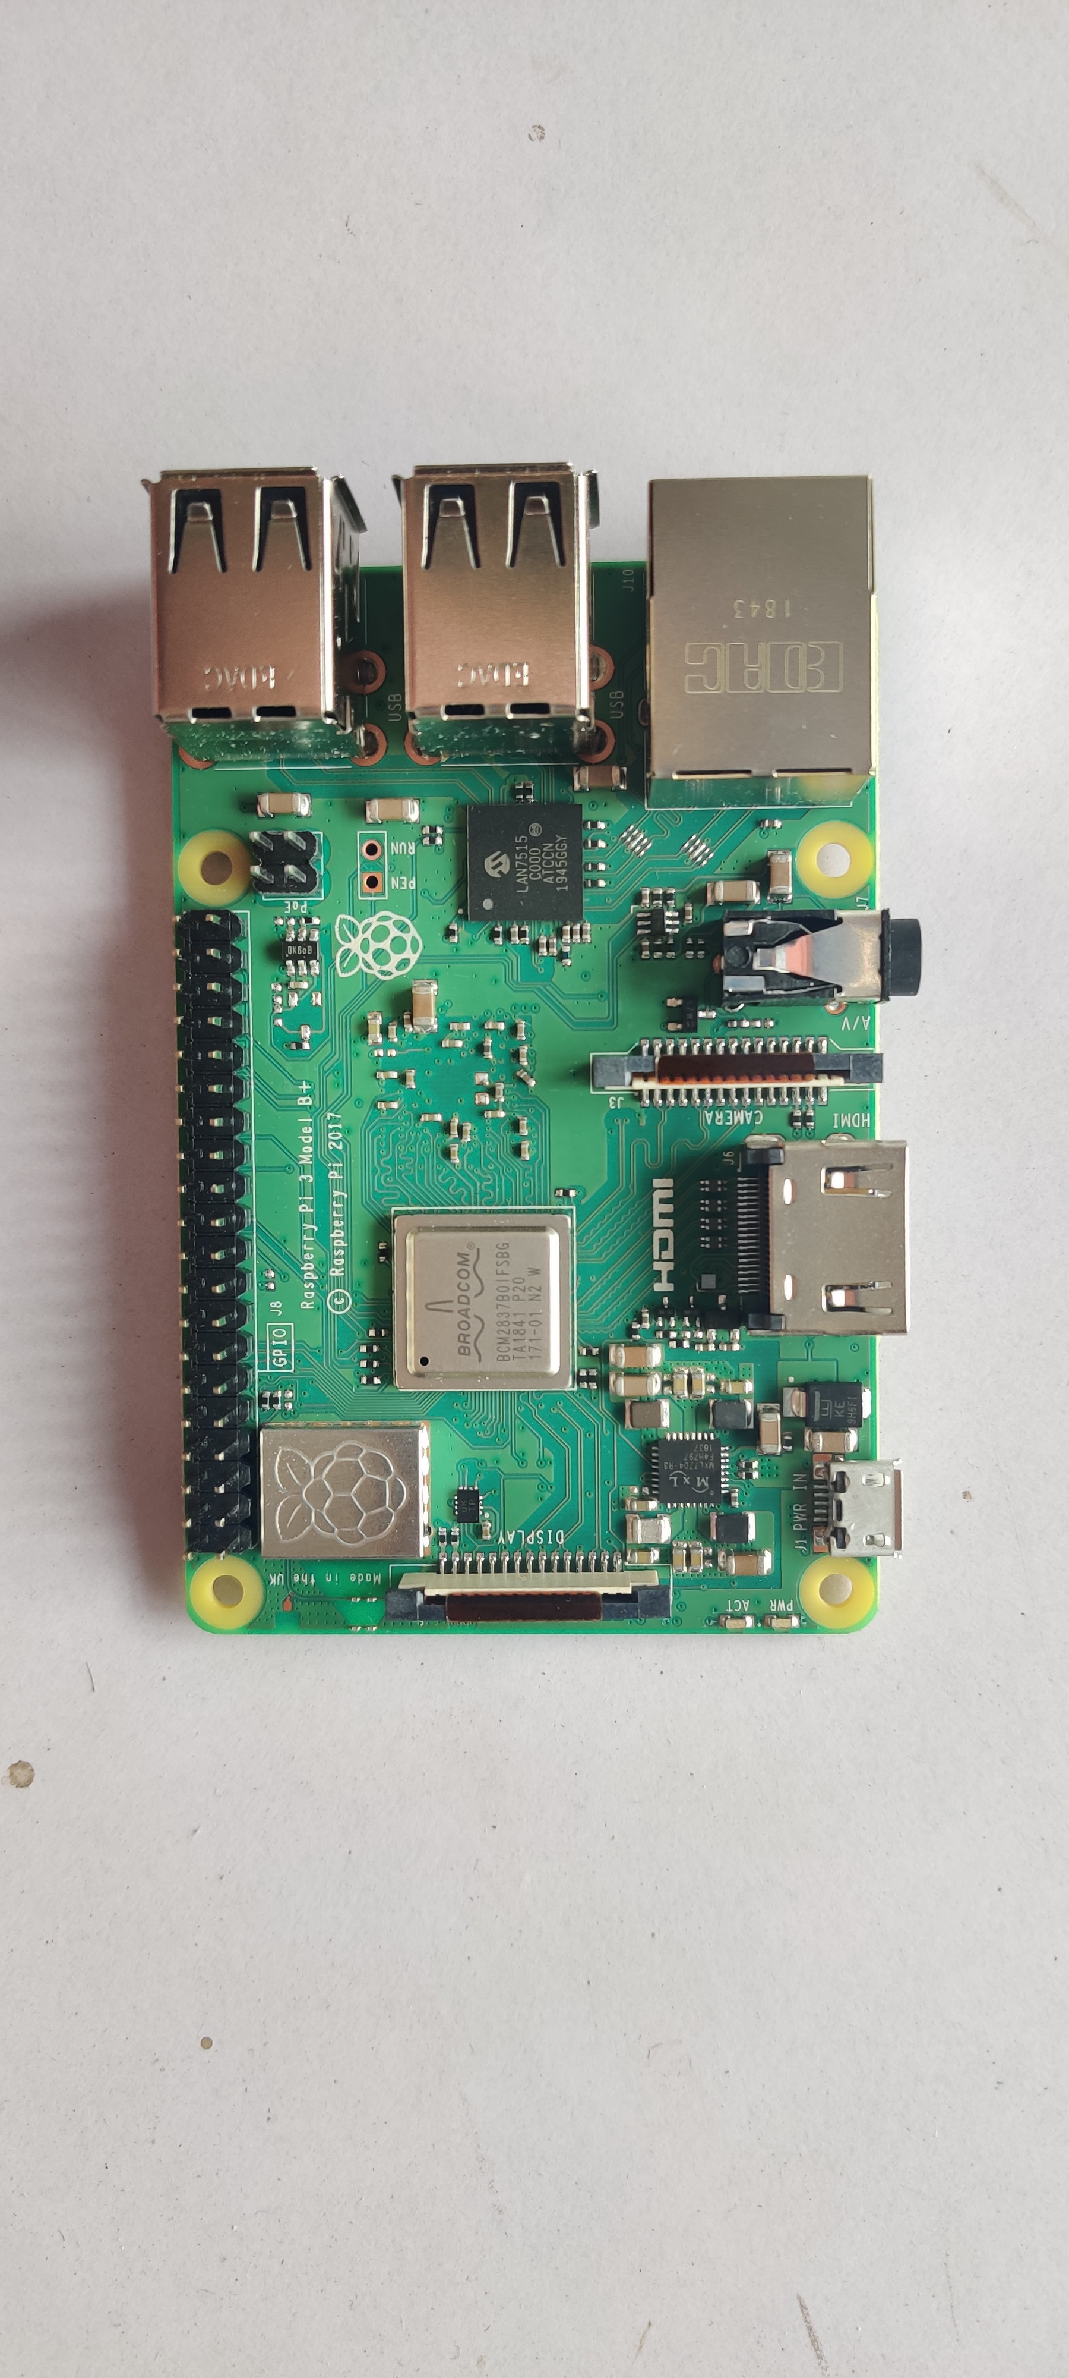
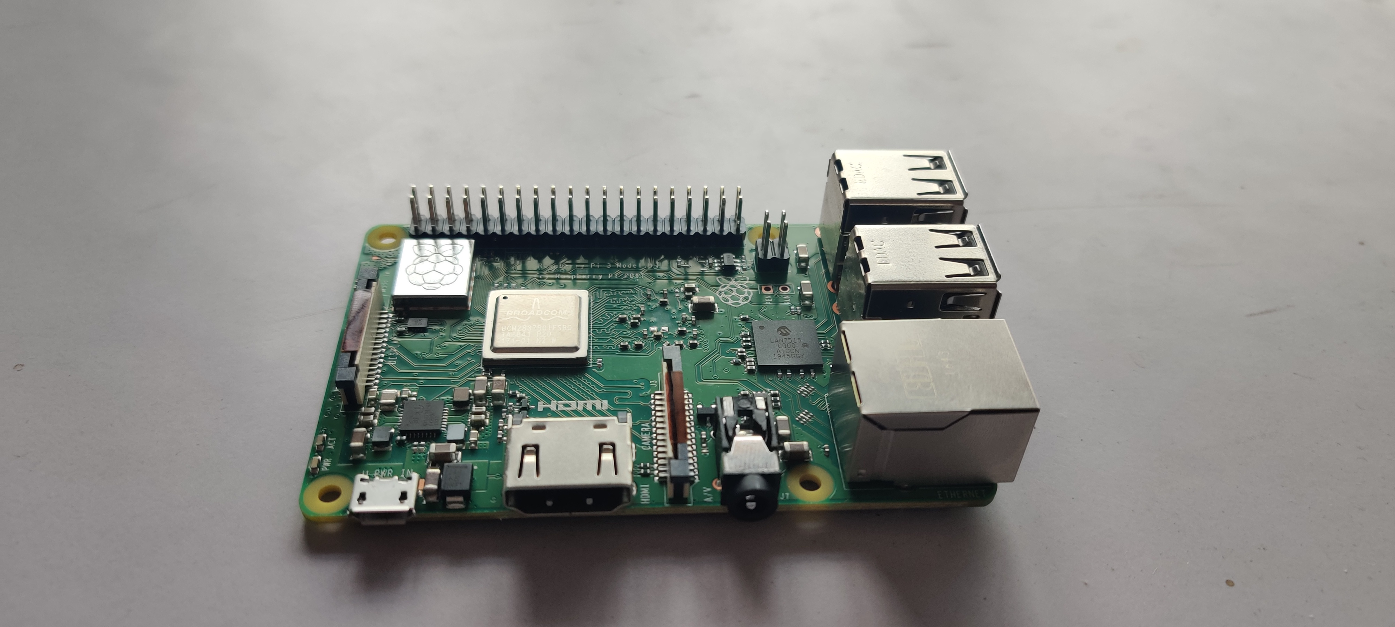
RASPBERRY PI3
The Raspberry Pi is a low cost, credit-card sized computer that plugs into a computer monitor or TV, and uses a standard keyboard and mouse. It is a capable little device that enables people of all ages to explore computing, and to learn how to program in languages like Scratch and Python.

Slide 6
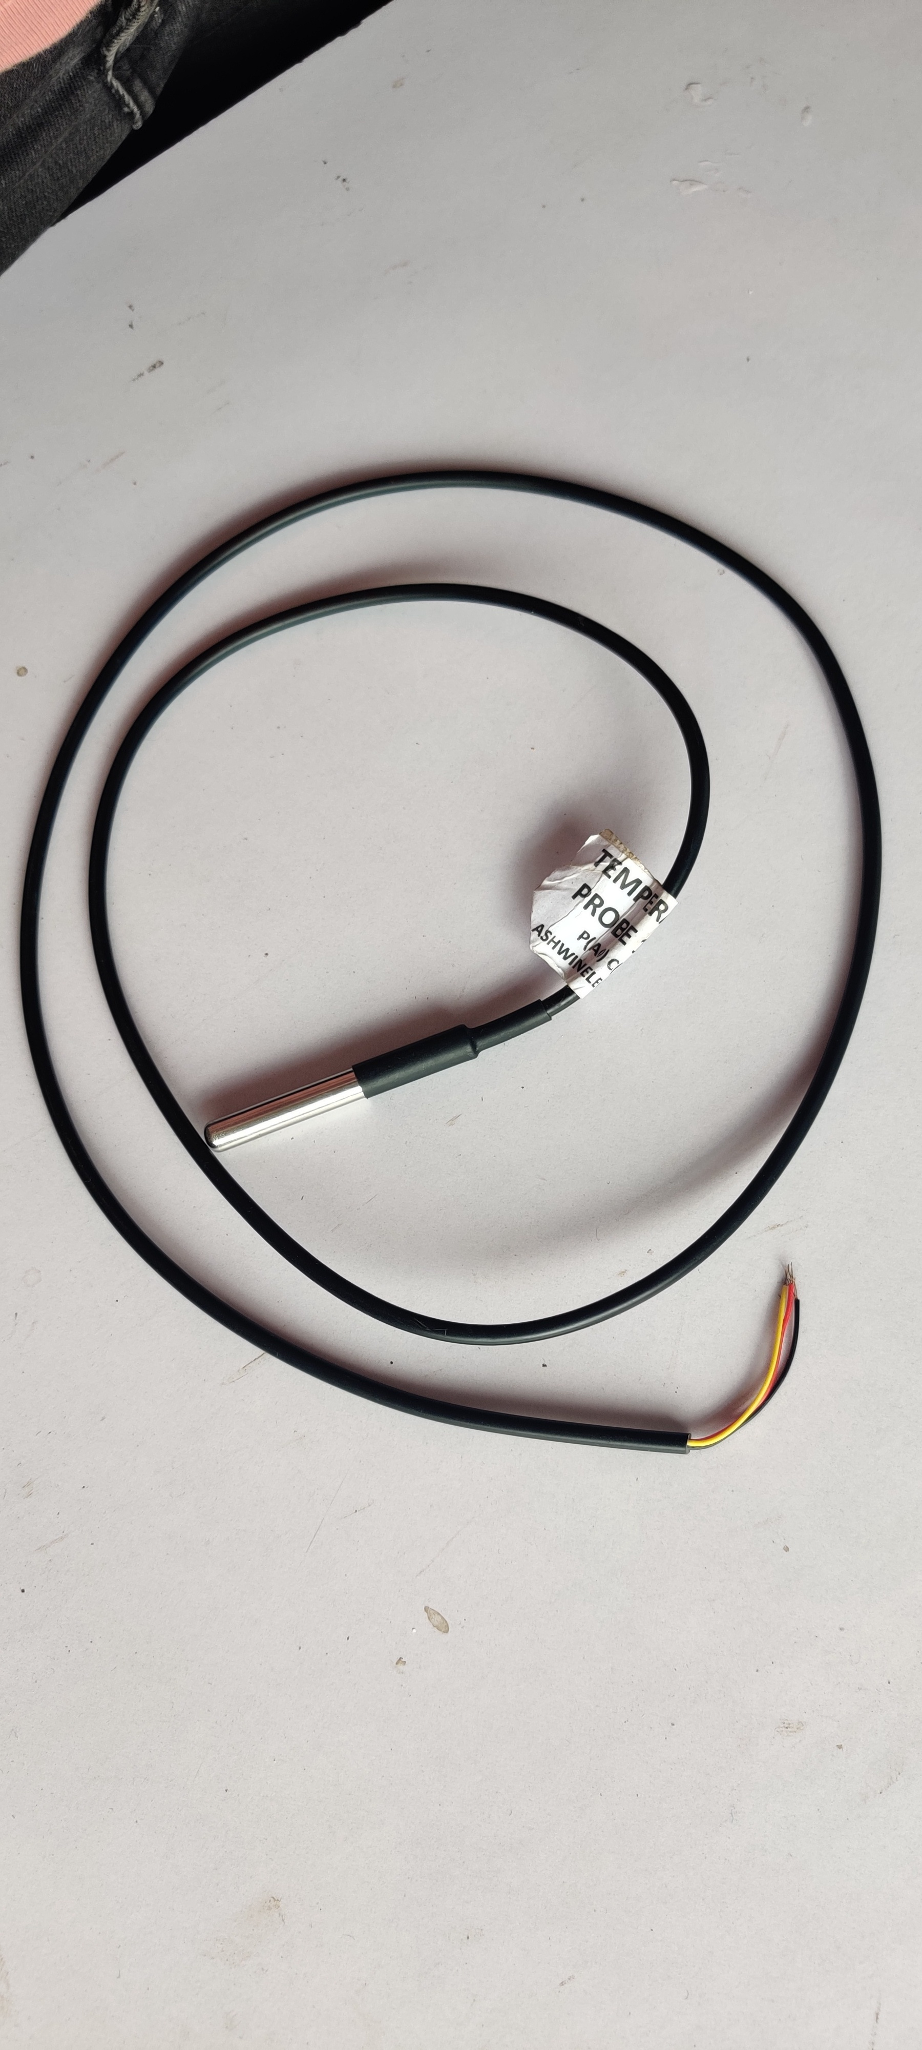
DS18B20 TEMPERATURE SENSOR
The DS18B20 Digital Thermometer provides 9 to 12-bit (configurable) temperature readings which indicate the temperature of the device. The DS18B20 communicates over a 1-Wire bus Power supply range is 3.0V to 5.5V
Measures temperatures from -55°C to +125°C. Fahrenheit equivalent is -67°F to +257°F
±0.5°C accuracy from -10°C to +85°C
Converts 12-bit temperature to digital word in 750 ms (max.)
The DS18B20 Sensor in our Hydroponic System is used to continuously monitor the Temperature of the nutrient solution which helps in reflecting the changes in blynk application. The nutrient solution has to maintain a temperature of 15-30 degrees Celsius for growing spinach.

Slide 7
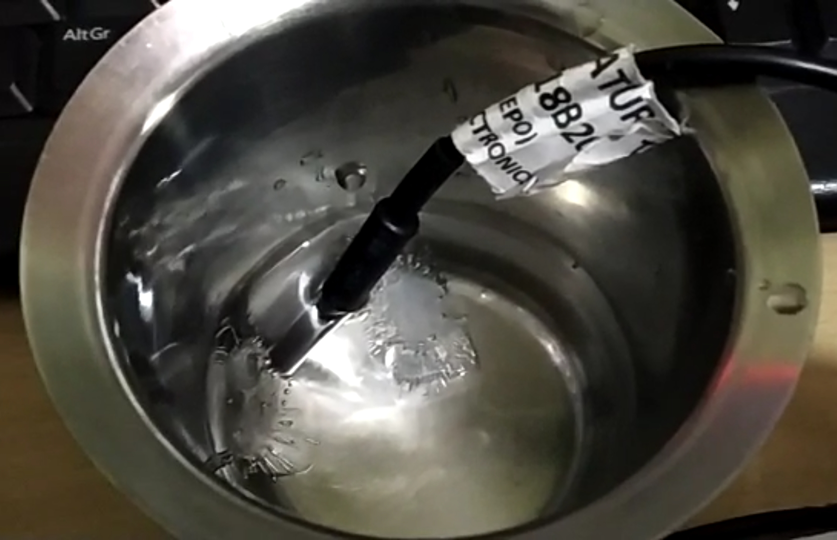
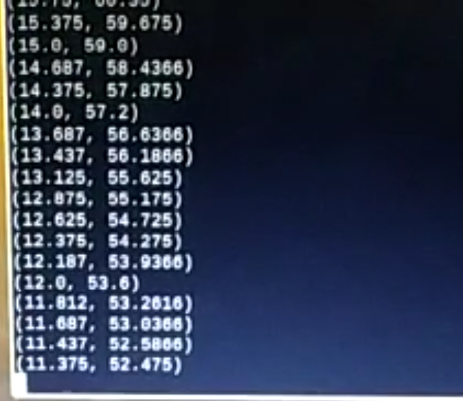
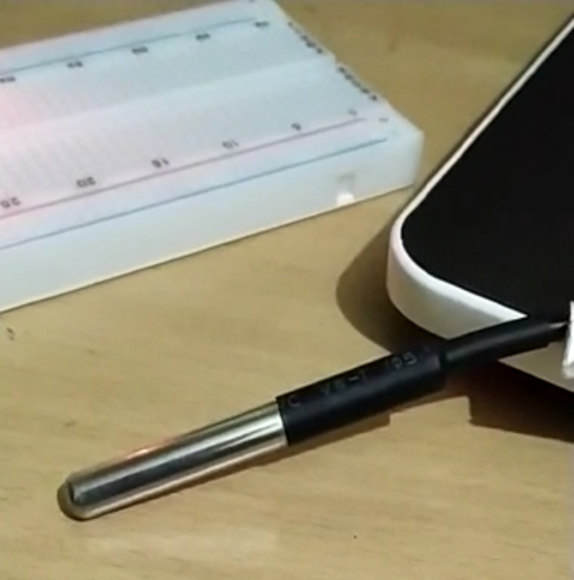
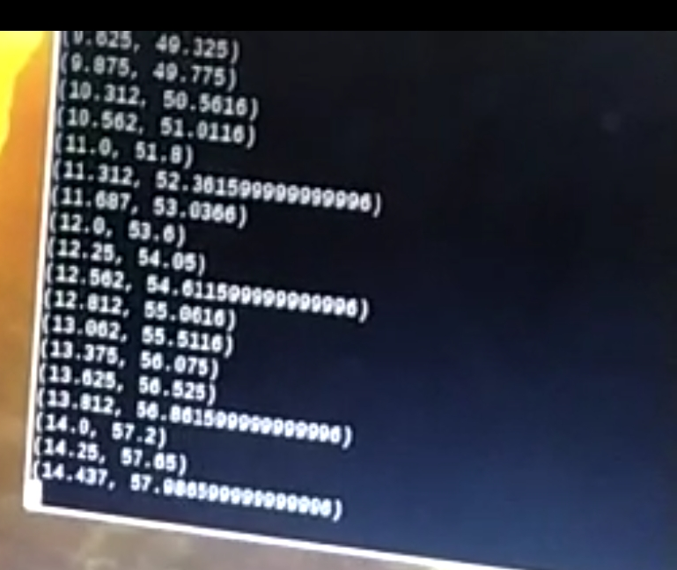
Temperature sesor dipped in icewater monitor displaying the temperature
Temperature sensor exposed to environment monitor displaying temperature

Slide 8
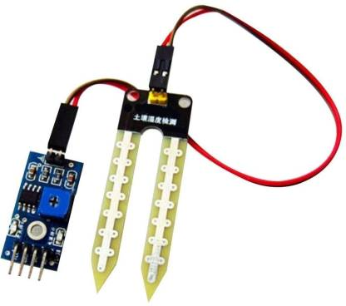
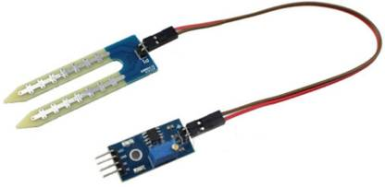
Soil moisture sensor
This is a simple water sensor can be used to detect soil moisture when the soil moisture deficit module outputs a high level, and vice versa output low. Use this sensor produced an automatic plant waterer device, so that the plants in your garden without people to manage.
Sensitivity adjustable the blue digital potentiometer adjustment
Operating voltage 3.3V-5V
Module dual output mode, digital output, analog output more accurate.
With fixed bolt hole for easy installation
PCB size: 3cm * 1.6cm
Power indicator (red) and digital switching output indicator (green)

Slide 9
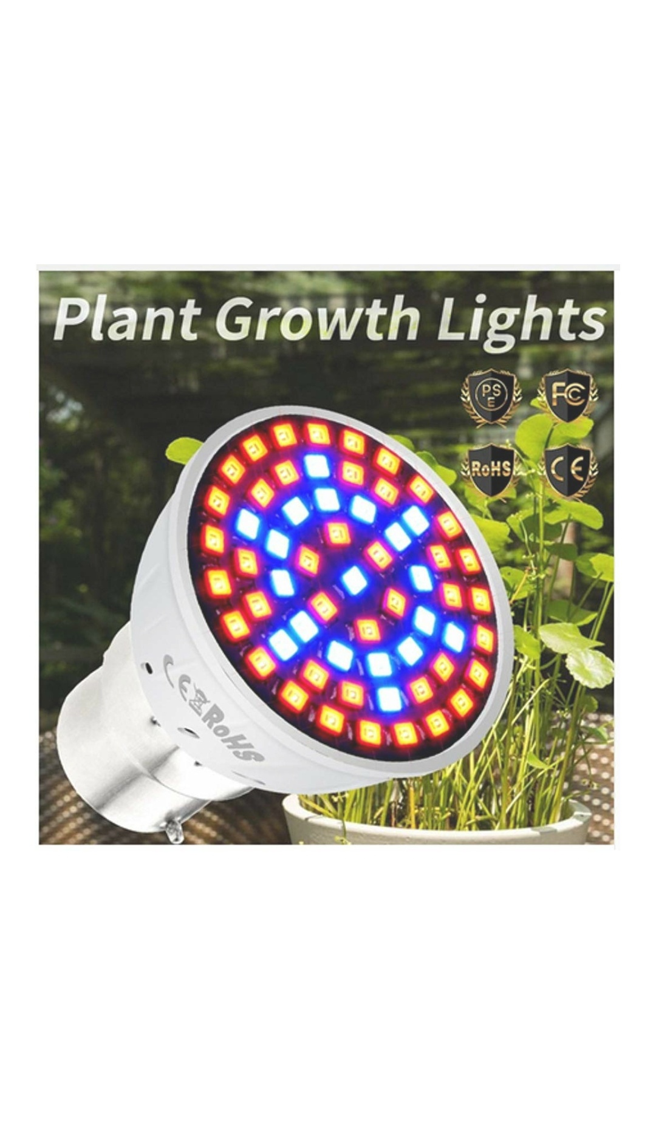
PLANT GROWTH LIGHTS
Specifications: Item Type: Grow Light Input Voltage: AC220V Power:3W Full Spectrum: Red+Blue LED Quantity: 60pcs (41pcs Red+19pcs Blue) Lumens: 250lm Size: Dia 48*50mm Features: -Contains no harmful elements, environmental friendly -Low power consumption and high luminous efficiency -Universal E27 bulb makes setup and use easy -Ideal for all plants which work on soil or hydroponic methods of growing in any indoor environment Red / Blue light important for plants: 1. Red light is very important to plant reproduction. Phytochrome pigments absorb the red and far red portions of the light spectrum and regulate seed germination, root development, tuber and bulb formation, dormancy, flowering and fruit production. 2. Blue light stimulates Chlorophyll production more than any other color, encouraging thick leaves, strong stems and compact vegetative growth.

Slide 10
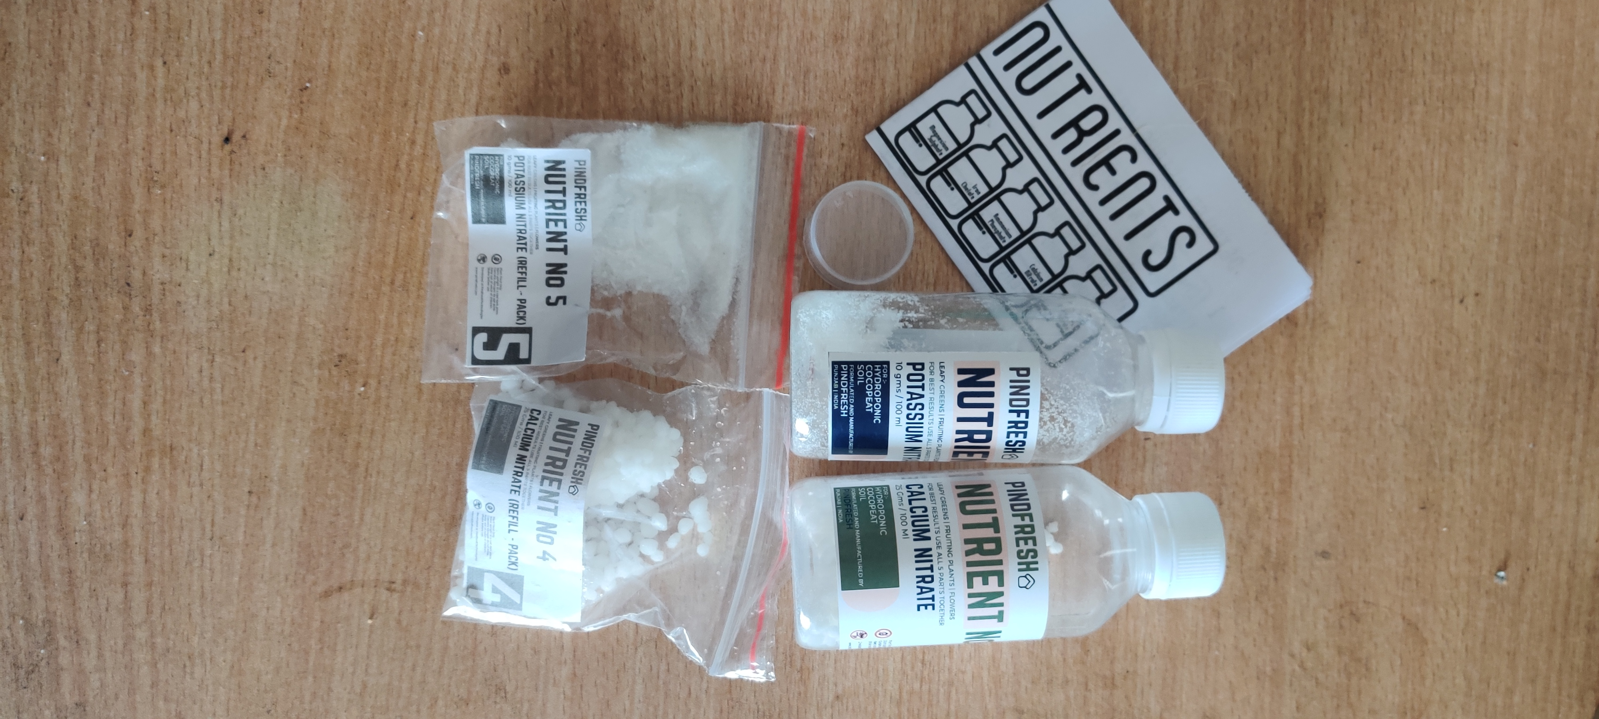
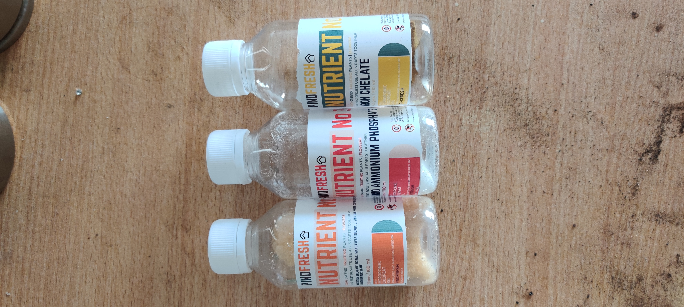
NUTRIENTS
NOURISHMENT FOR ANY PLANT - Ideal set of nutrients that make any plant (like VEGETABLES, FRUITS, FLOWERS OR HERBS) healthy. You can use it in HYDROPONIC SYSTEMS, SOIL OR COCOPEAT FARMING.
HIGH QUALITY POWDER CONCENTRATE -Contains highly purified concentrates for maximum solubility, optimum nutrition and even fruiting, flowering and blooming of the plant.
QUICK ABSORPTION - All the ingredients are easily absorbed by the plant through the roots. The nutrient intake is extremely quick which enables the plant to focus on growing rather than spending its energy on active transport of nutrients.
Part 1: Micro Nutrients - EpsomSalt,Borax,ManganeseSulphate,ZincSulphate,CopperSulphate,Common Salt, Ammonium Molybdyte.
Part 2: Iron Chellate
Part 3: Mono Ammonium Phosphate
Part 4: Calcium Nitrate
Part 5: Potassium Nitrate

Slide 11
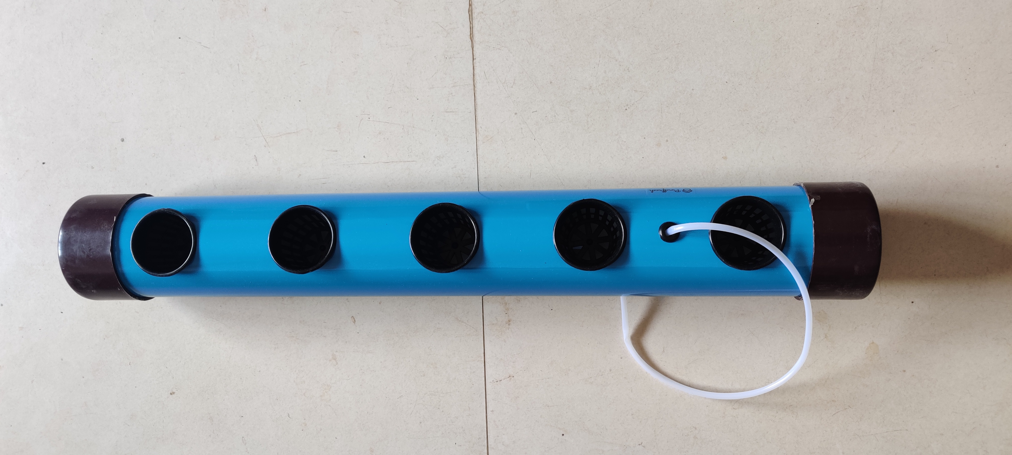
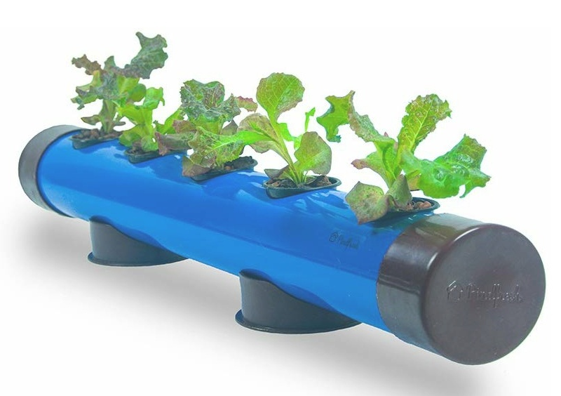
Yield: A Pindpipe can grow upto 5 plants. Seeds: Sow about 5-6 seeds in each net pot or transplant after germination. Average Output : 100 gms per net pot (For Lettuce) Technology Used: Deep Water Culture (DWC) | Dimensions: Pindpipe Length = 26 inches Pindpipe Diameter = 3 inches Stand Width = 4 inches Net Pot Diameter = 2 inches | Material: For the pipe we used Food Grade PVC.

Slide 12
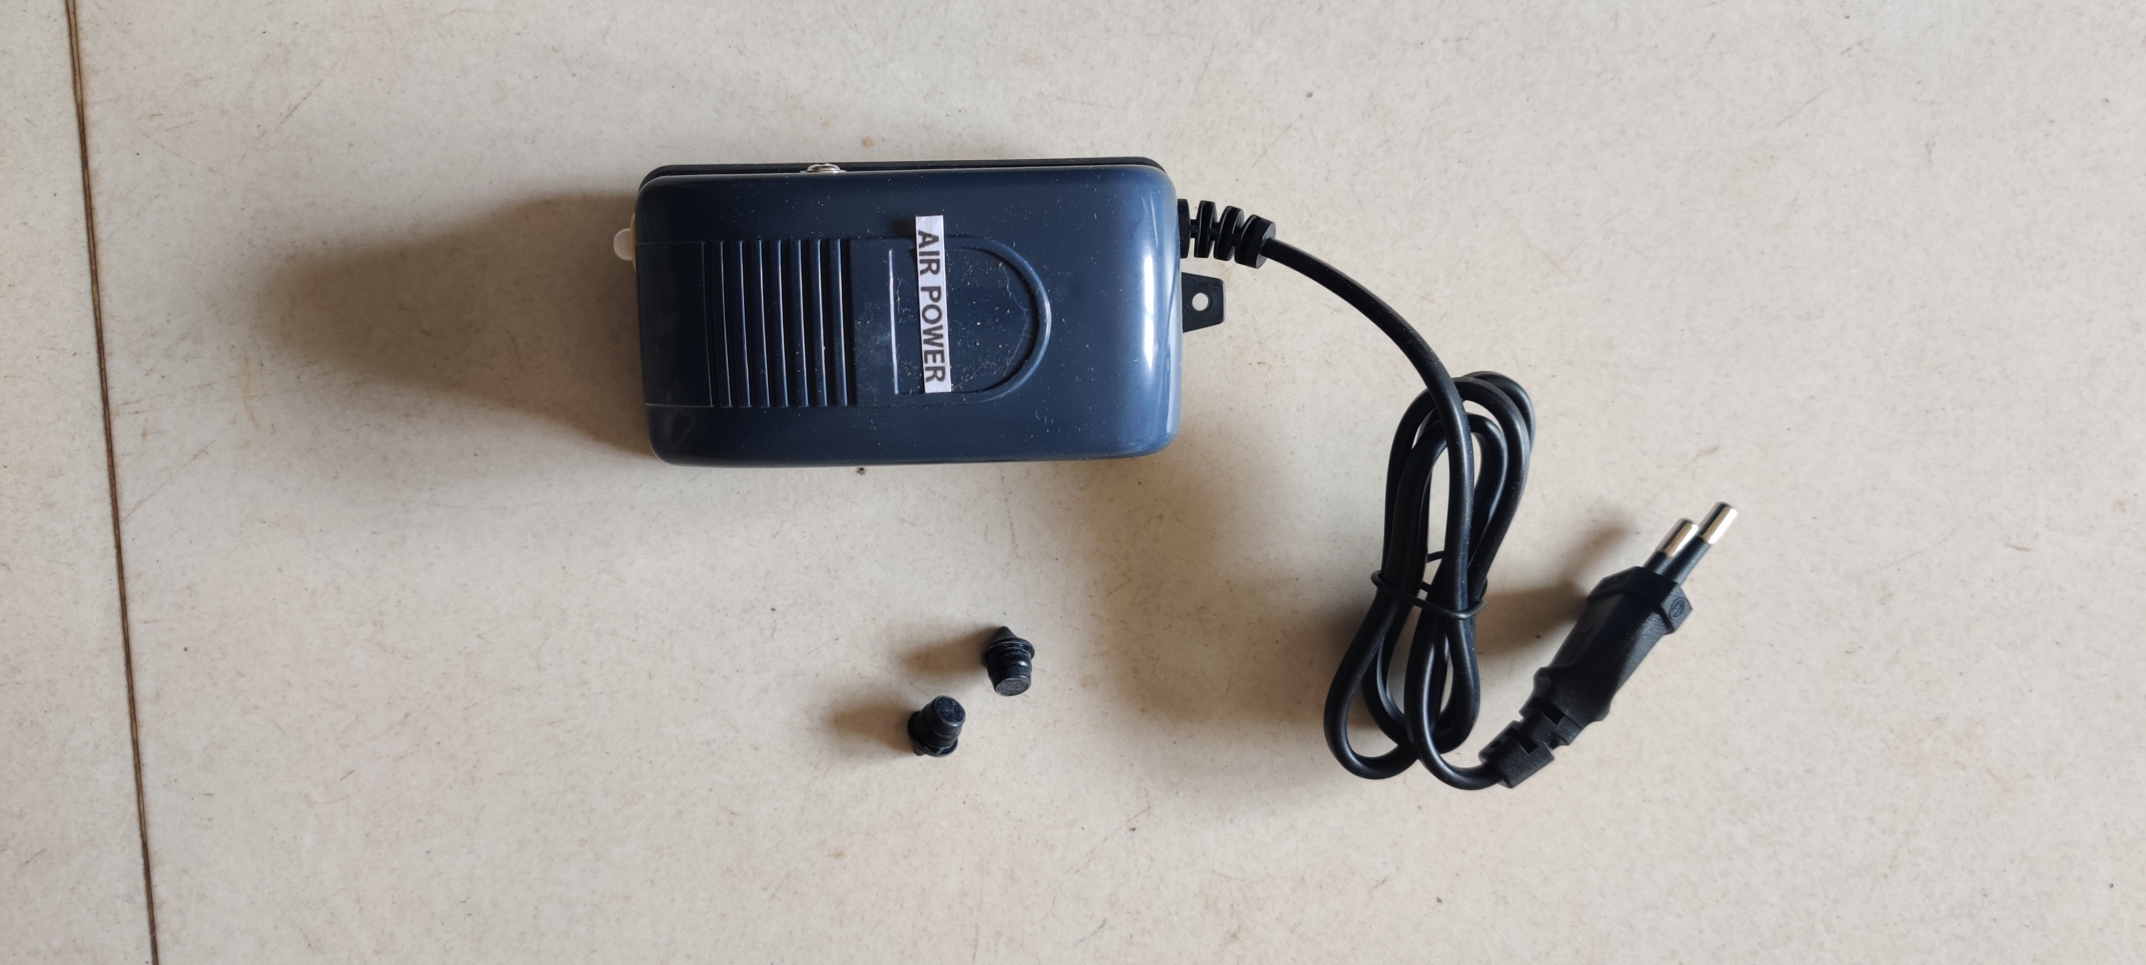
AIR PUMP
Plants need oxygen to survive. That's why it's super important to give them enough of this in water systems like hydroponics or aquaponics.If so, an air pump is your best friend.
Air pump is with silicone tubing and Airstone.It continuously oxygenate the water solution

Slide 13
METHODOLOGY
By using microcontrollers and sensors, monitoring of parameters pH, electrical conductivity(EC),and water luminosity is done.
The microcontroller will continously monitor the water conditions where the plant is placed.
we are monitoring pH, water conductivity and luminosity to achieve optimal growth of plants. In hydroponics the plants need to be kept at specific age value (typically 5 to 5.5) the water that we get in the tap does not have suitable pH value. The pH value had to be constantly monitored on daily bases.
Giving lights to the plants is another major factor. In hydroponics plants need to be kept under light for 16 hours and in the dark for 8 hours to get maximum yield. For this we are using microcontroller through which we will turn ON/OFF the light .

Slide 14
Diagram of proposed system
Microcontroller
LCD
pH sensor
relay
Water conductivity
Power supply
RTC

Slide 15
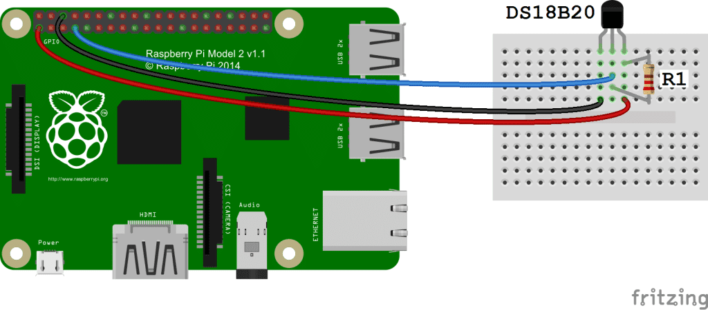
WIRING FOR SSH TERMINAL OUTPUT
Follow this wiring diagram to output the temperature to an SSH terminal:

Slide 16
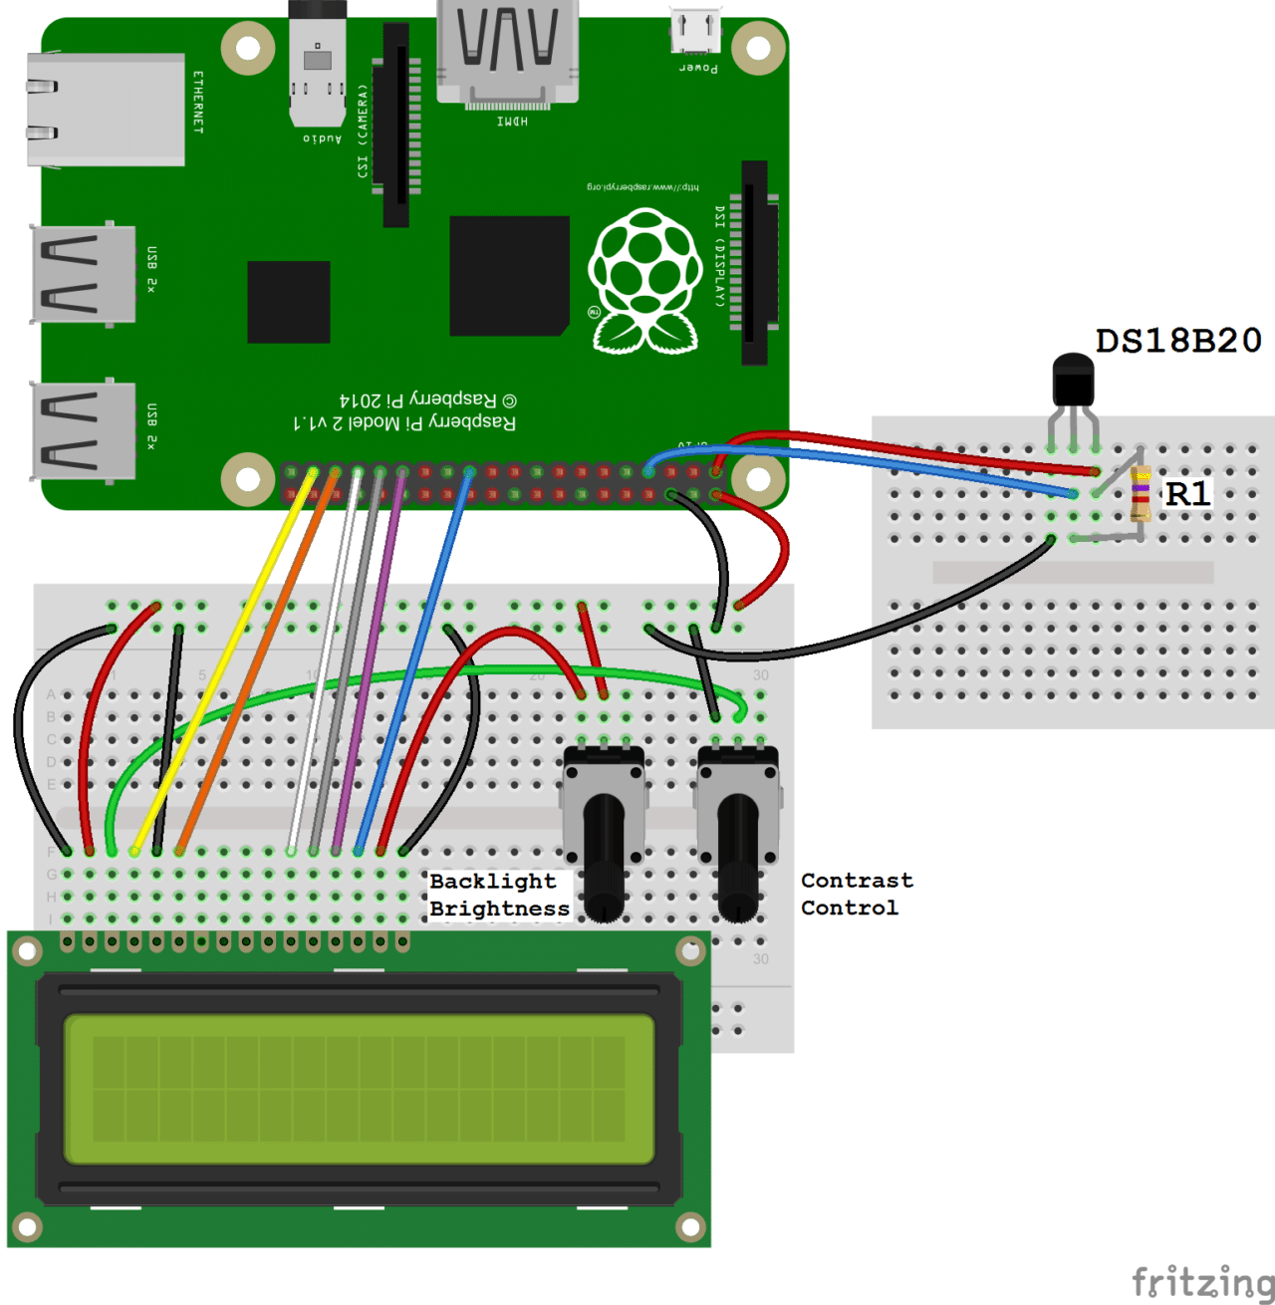
WIRING FOR LCD OUTPUT
Follow this diagram to output the
temperature readings to an LCD:

Slide 17
ADVANTAGES
No soil needed.
pH control of solution.
Make better use of space location.
Climate control.
Effective use of nutrients.
Better growth rate.
No weeds.
Labor and time saver.
Less space required.

Slide 18
DISADVANTAGES
Requires commitment.
Diseases and pets may spread quickly.
Initial expenses.
Water and electricity risks.

Slide 19
REFERENCE
[1] P Sihombing,N A Karina, J T Tarigan, M I Syarif,Universities Sumatera Utara- automated hydroponics nutrition plants systems using arduino UNO microcontroller based on android-March,2018
[2] Masoud Torabi, Ali Akbar,Mokhtarzadeh and Mahlooji, seed and plant improvement institute(SPII), Iran-Role of hydroponics technique as a standard methodology in various aspects of plant biology researches-March,2012
[3] Vaibhav Palande, Adam Zaheer and Kiran George, college of engineering and computer science, California state university, United States-Fully automated hydroponic system for indoor plant growth-Jan,2018
[4] Jyoti Vilas Gosavi, Zeal college of engineering and research, Pune-July,2017

Slide 20
THANK YOU

